Slide 1

OOP -
Polymorphism

Slide 2
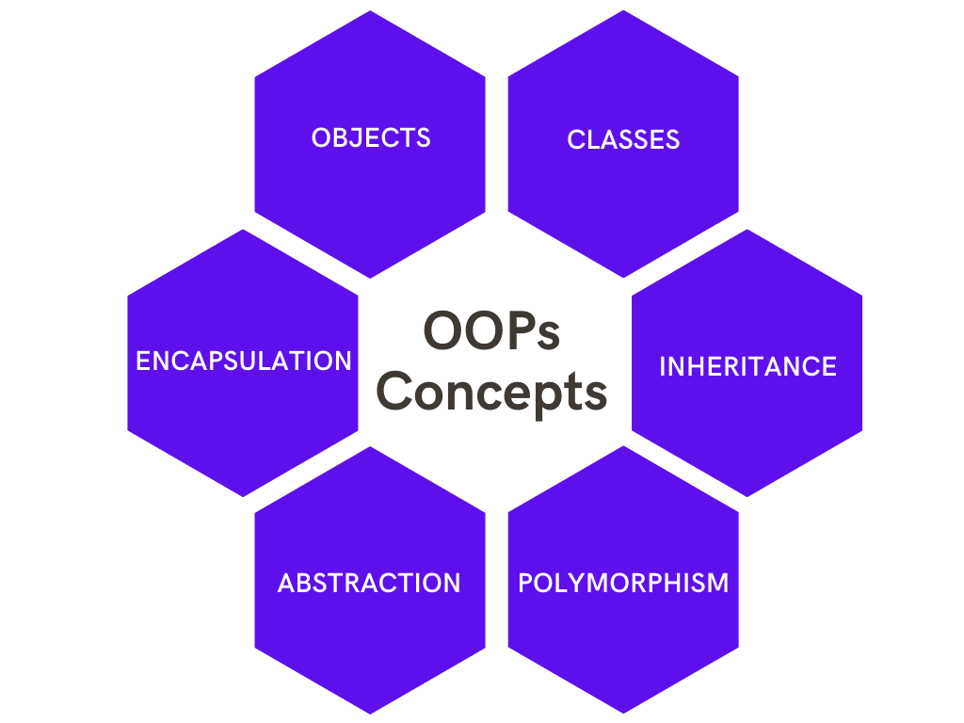

Slide 3
Polymorphism nima?
Polymorphism – bir obyektning ko’p formalik holatini ochib beradi. Ya’ni obyektga tegishli bo’lgan biror bir metodni ko’plab ko’rinishlarini hosil qilish mumkin.

Slide 4
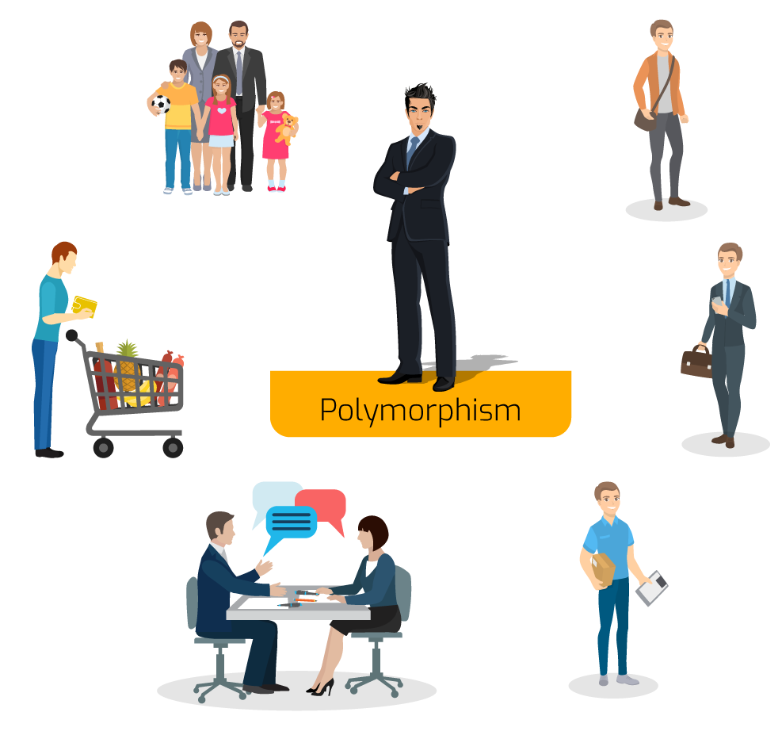

Slide 5
Polymorphism
Static
Dynamic
Method Overloading
Operator Overloading
Method Overriding

